Slide 1


KEYLOGGER
APSSDC
Bheesetti
Mohan
01
Notes:
Bhesetti mohan

Slide 2

INTRODUCTION
A keylogger, short for keystroke logger, is a type of surveillance technology used to monitor and record each keystroke typed on a computer's keyboard. This data is then stored locally or transmitted to a remote server.
Legitimate Uses: Keyloggers can be used by employers to monitor employee activity, by parents to supervise their children's computer usage, and for other lawful monitoring purposes.
Malicious Uses : Cybercriminals use keyloggers to steal sensitive information such as usernames, passwords, credit card numbers, and other confidential data for fraudulent activities.
02

Slide 3

PROBLEM STATEMENT
Cybersecurity Threat
Increasing Threat of Keyloggers:
Keyloggers are becoming more sophisticated and harder to detect.
Frequently used by cybercriminals to gather sensitive information.
Impact on Users
Consequences of Keylogger Attacks:
Data Breaches: Capture login credentials, leading to unauthorized access.
Financial Loss: Stolen financial information can result in monetary loss.
Identity Theft: Personal information used for identity theft, causing long-term damage.
03

Slide 4

PROJECT OVERVIEW
The primary goal of this project is to develop and analyze a keylogger for educational purposes. This includes understanding how keyloggers function, their potential impacts, and how to defend against them.
Scope
Development Phase:
Design and implement a basic keylogger using programming languages and libraries.
Testing Phase:
Test the keylogger in a controlled environment to evaluate its functionality.
Analysis Phase:
Analyze the captured data to understand the keylogger's effectiveness.
Technologies Used
Programming Languages:
Python
Keystroke Capture Libraries:
pynput
pyHook (for Windows)
keyboard (cross-platform)
Development Tools:
Integrated Development Environment (IDE) like PyCharm or Visual Studio Code
Version control system like Git
Testing and Analysis Tools:
Virtual machines or sandbox environments for safe testing
Log analysis tools
04

Slide 5


TARGET AUDIENCE
Cybersecurity Professionals
Purpose: To develop and implement countermeasures against keyloggers.
Ethical Hackers
Purpose: To conduct penetration testing and improve overall security posture.
Educators and Students
Purpose: To serve as a teaching tool illustrating the importance of cybersecurity measures.
05

Slide 6


SOLUTION & VALUE PROPOSITION
Creation for Educational and Defensive Purposes:
Purpose: An ethical keylogger is designed to be used as a tool for educational and defensive cybersecurity purposes.
Educational Use:
Demonstrates how keyloggers operate, providing insights into their mechanisms and behaviors.
Defensive Use:
Assists in developing robust security measures by understanding potential vulnerabilities exploited by malicious keyloggers.
Defensive Strategies:
Building Resilience:
Helps in creating more resilient security systems by knowing the tactics and techniques used by attackers.
Enhanced Detection:
Contributes to the development of advanced detection tools and methods to identify and neutralize keyloggers.
06

Slide 7



TECHNICAL IMPLEMENTATION
User Input Device (Keyboard): The source of keystrokes.
Keylogger Software/Hardware:
Kernel-Level Keylogger: Intercepts keystrokes at the kernel level.
Application-Level Keylogger: Monitors keystrokes at the application level.
Data Capture Module: Captures and records keystrokes.
Data Storage Module: Stores captured keystrokes locally or sends them to a remote server.
Data Transmission Module (for remote keyloggers): Sends captured data over the network to the attacker.
07

Slide 8
+--------------------+
| Start |
+--------------------+
|
v
+--------------------+
| Initialize Keylogger|
+--------------------+
|
v
+--------------------+
| Capture Keystrokes |
+--------------------+
|
v
+--------------------+
| Process Keystrokes |
+--------------------+
|
v
+----------------+-----------------+
| |
v v
+------------------+ +-----------------+
| Store Locally | | Transmit to |
| (local file) | | Remote Server |
+------------------+ +-----------------+
|
v
+--------------------+
| Continue Capturing |
| Keystrokes |
+--------------------+
|
v
+--------------------+
| Stop |
+--------------------+
+------------------+
| User Input Device|
| (Keyboard) |
+--------+---------+
|
v
+--------+---------+
| Keylogger (Software/Hardware)|
+--------+---------+
|
v
+--------+---------+
| Data Capture |
| Module |
+--------+---------+
|
v
+--------+---------+
| Data Storage |
| Module |
+--------+---------+
|
v
+------------+------------+
| Data Transmission Module|
| (for remote keyloggers) |
+-------------------------+
|
v
+--------+---------+
| Attacker's Server|
+------------------+
08

Slide 9
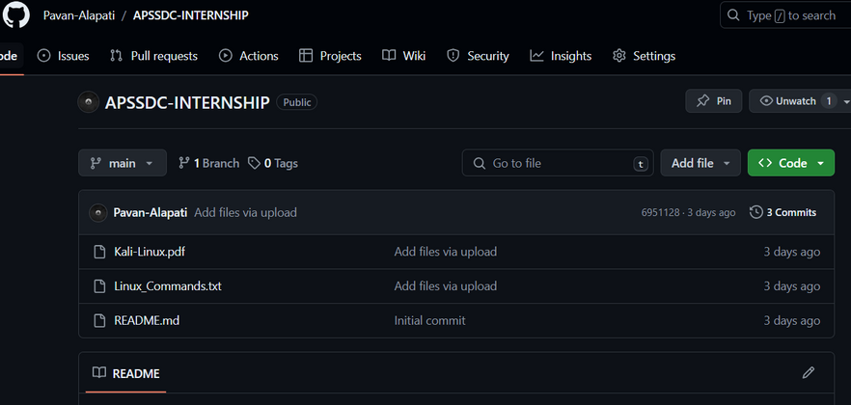

https://github.com/Pavan-Alapati/APSSDC-INTERNSHIP
ALAPATI PAVAN
OXAPAVAN@GMAIL.COM
09

Slide 10
THANK YOU
APSSDC
10

